Slide 1
Nursing House System
Implemented by JY.Cui ,YJ.Li ,J.li
Interactive
easy-to-use
Functional
characteristic

Slide 2
CONTENTS
1
Problem Statement
1
Problem Statement
2
Approach
3
Object Model
4
Functionalities
5
Main Screenshots

Slide 3

Statement
The number of Americans ages 65 and older is projected to more than double from46 million today to over 98 million by 2060, and the 65-and-older age group‘s share of the total population will rise to nearly 24 percent from 15 percent.And that’s to say:
More and more elders are needing care!
1
点击添加标题

Slide 4
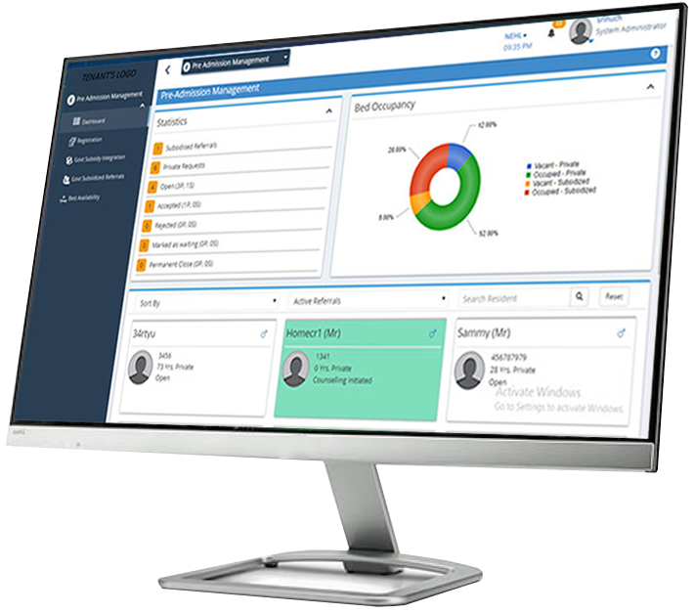
Statement
Problem：
Social and life pressures have led more and more people to send elderly people to nursing houses. With more and more elderly people living in nursing houses, nursing houses also need to get rid of the traditional management and use a new set of nursing home management system. In fact, there are many nursing house systems on the market nowadays. But most of them have a variety of drawbacks. Here’s how:
1
点击添加标题

Slide 5
Statement
1
点击添加标题
Low management efficiency
Absence of interaction of the elderly
Only management without analysis
Lack of ease of use
A failed system
4
Simplify the process
Involve the elderly
Make the analysis
Simplify the interface
Try to improve

Slide 6
Statement
Admin&NursingWorker
admin
NursingWorker
Management of the Nursing Workers.
1
点击添加标题
Admin&Elder
Management of the elders.
elder
Elder&NursingWorker
Taking care of the elders.
Whole system worked
Our task is to design a nursing home monitoring system and take the nursing home under the operation of the system as the enterprise, form a network, complete the basic nursing home monitoring and data analysis at different levels, and then promote the healthy operation of the whole system and better monitor the health of the elderly.

Slide 7
CONTENTS
1
Problem Statement
2
2
Approach
Approach
3
Object Model
4
Functionalities
5
Main Screenshots

Slide 8

Approach for enterprise
1
点击添加标题
Administrator end
Elder end
NursingWorker end
Management and phased analysis of data
Illustration：
The interaction between administrators and the elderly is one-way, while the interaction between nurses and the elderly is two-way. But in the above three relationships, the most important is the relationship between the elderly and the caregivers and managers. These two relationships directly determine the accuracy and stability of high-level statistical data.

Slide 9
Approach for organization
elder
1
点击添加标题
admin
Simple Logic Oriented 1
interact
Close combination 2
Nursing
Information exchange at the bottom of the
Elderly and periodic summary by administrators 3
Direct communication with the elderly, timely
processing and filtering of information 4

Slide 10
Approach for network
Administrators receive the data
Analysis
Generating Data
1
点击添加标题
Finish
Periodic summary
View different type of data
Draw the conclusions and feedback

Slide 11
CONTENTS
1
Problem Statement
2
Approach
3
Object Model
3
Object Model
4
Functionalities
5
Main Screenshots

Slide 12
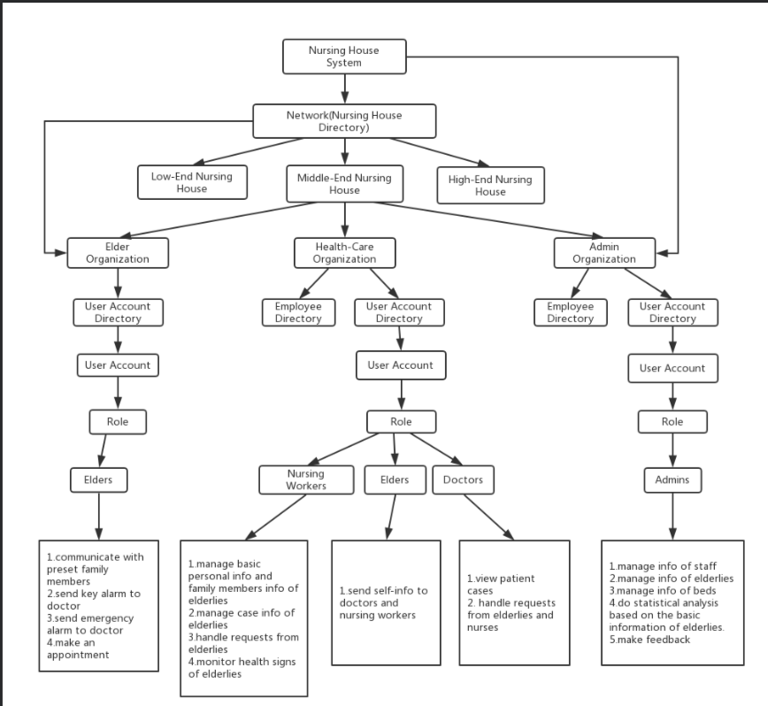
Object Model
1
点击添加标题

Slide 13
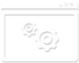
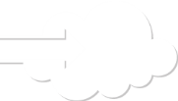

Object Model
Calculate and receive Data
1
点击添加标题
Do the hight-level things for the whole system.
Network
Lower Level
Build and upload Data
Including the whole parts that lower than Network, generating and collect the raw data for upper level.

Slide 14
CONTENTS
1
Problem Statement
2
Approach
3
Object Model
4
4
Functionalities
Functionalities
5
Main Screenshots

Slide 15
Functionality
Communicate with workers and families.
Emergency Help and Physical Signs Query
Elder
Elder
Managing and responding to the elderly，monitoring body status of elders
Complete communication with managers and the elderly and act as a bridge between them
Worker
Worker
Nursing
House
System
Low-level administrators can aggregate the underlying information and do managing
High-level administrators conduct data analysis and assessment of the whole system
Admin
Admin

Slide 16
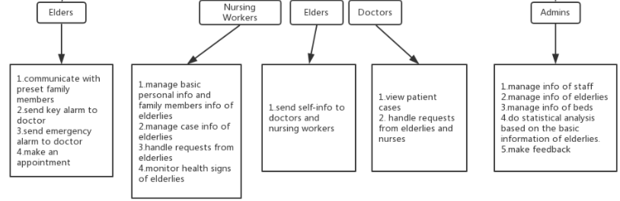
Functionalities
Specific functions
Each part has its own function, but it also plays an irreplaceable role in the whole system.
1
点击添加标题

Slide 17
CONTENTS
1
Problem Statement
2
Approach
3
Object Model
4
Functionalities
5
Main Screenshots
5
Main Screenshots

Slide 18
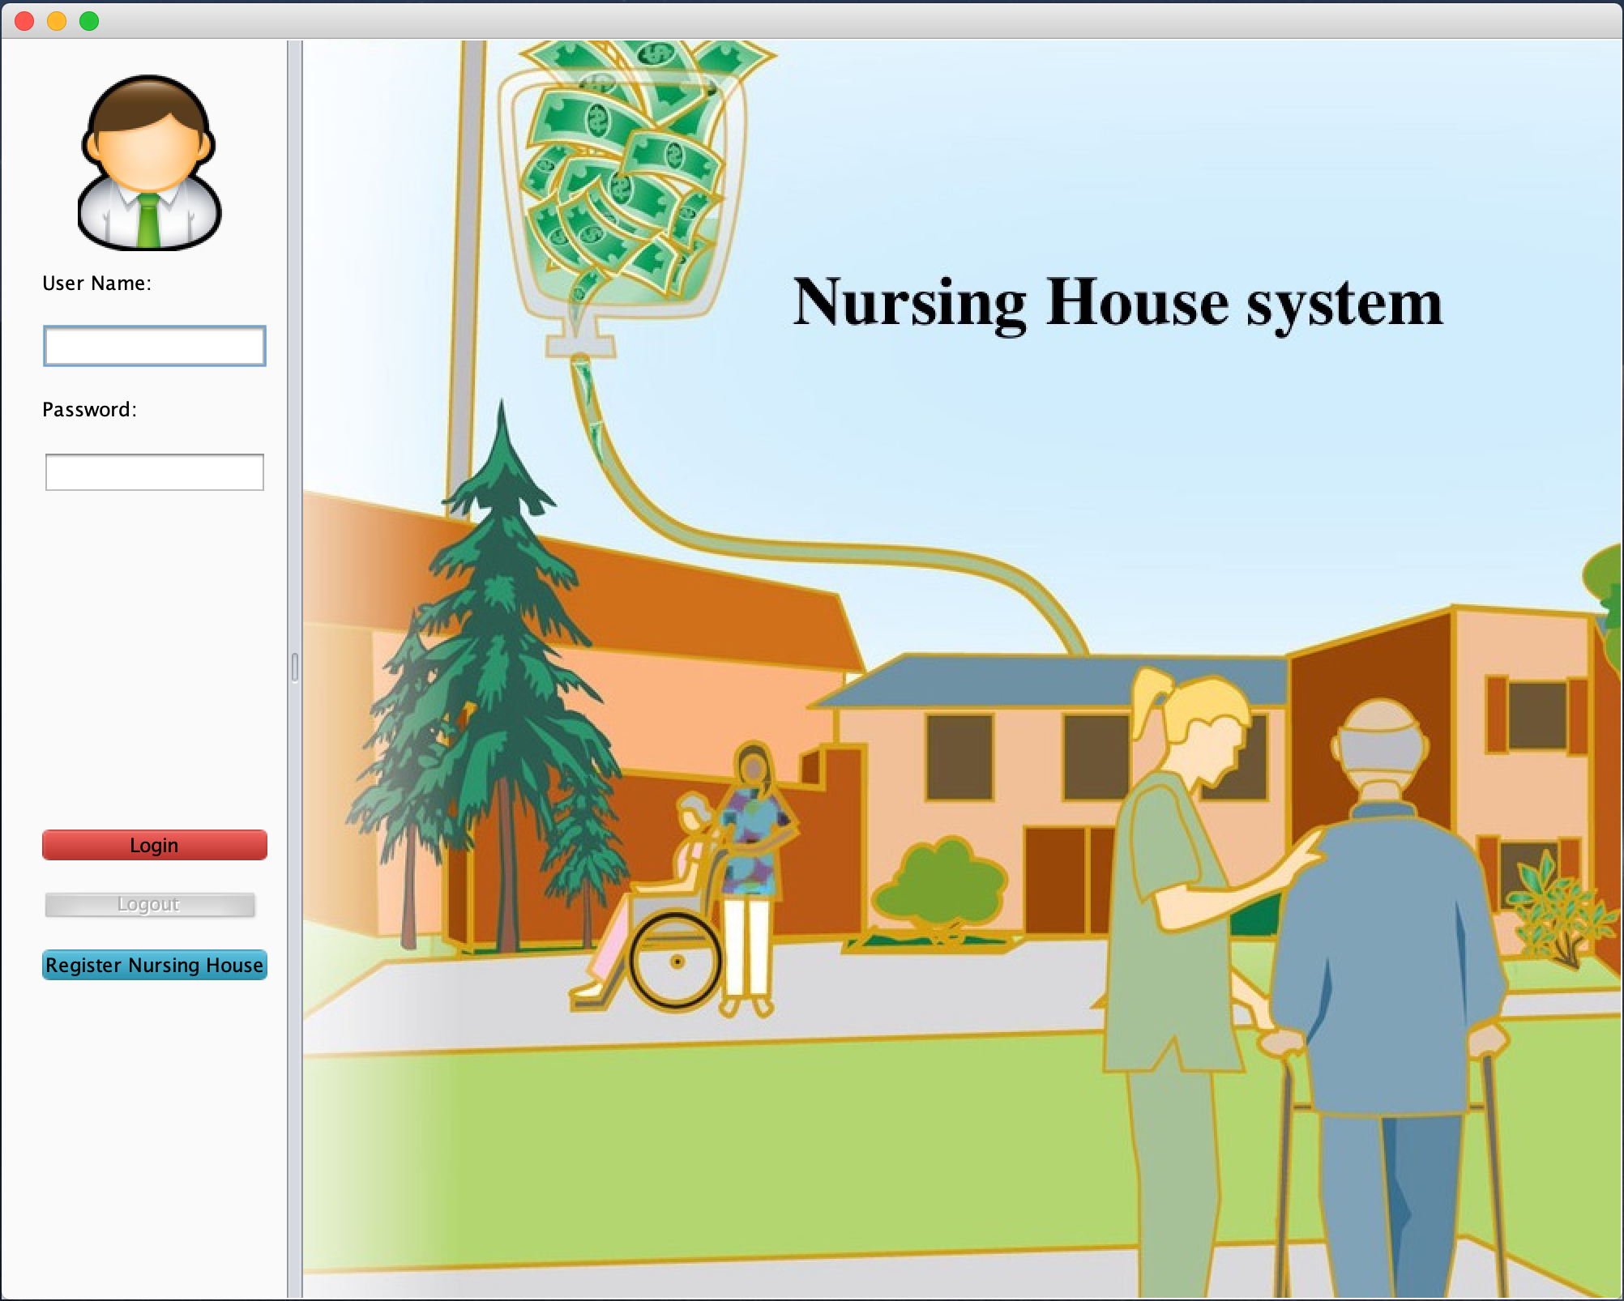
Main Screenshots
1
点击添加标题
Login Interface

Slide 19
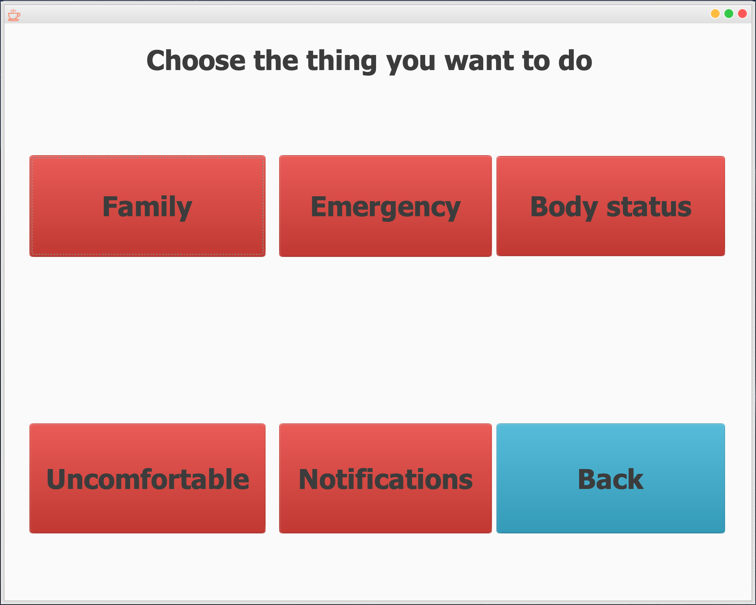
Main Screenshots
1
点击添加标题
Elder UI

Slide 20
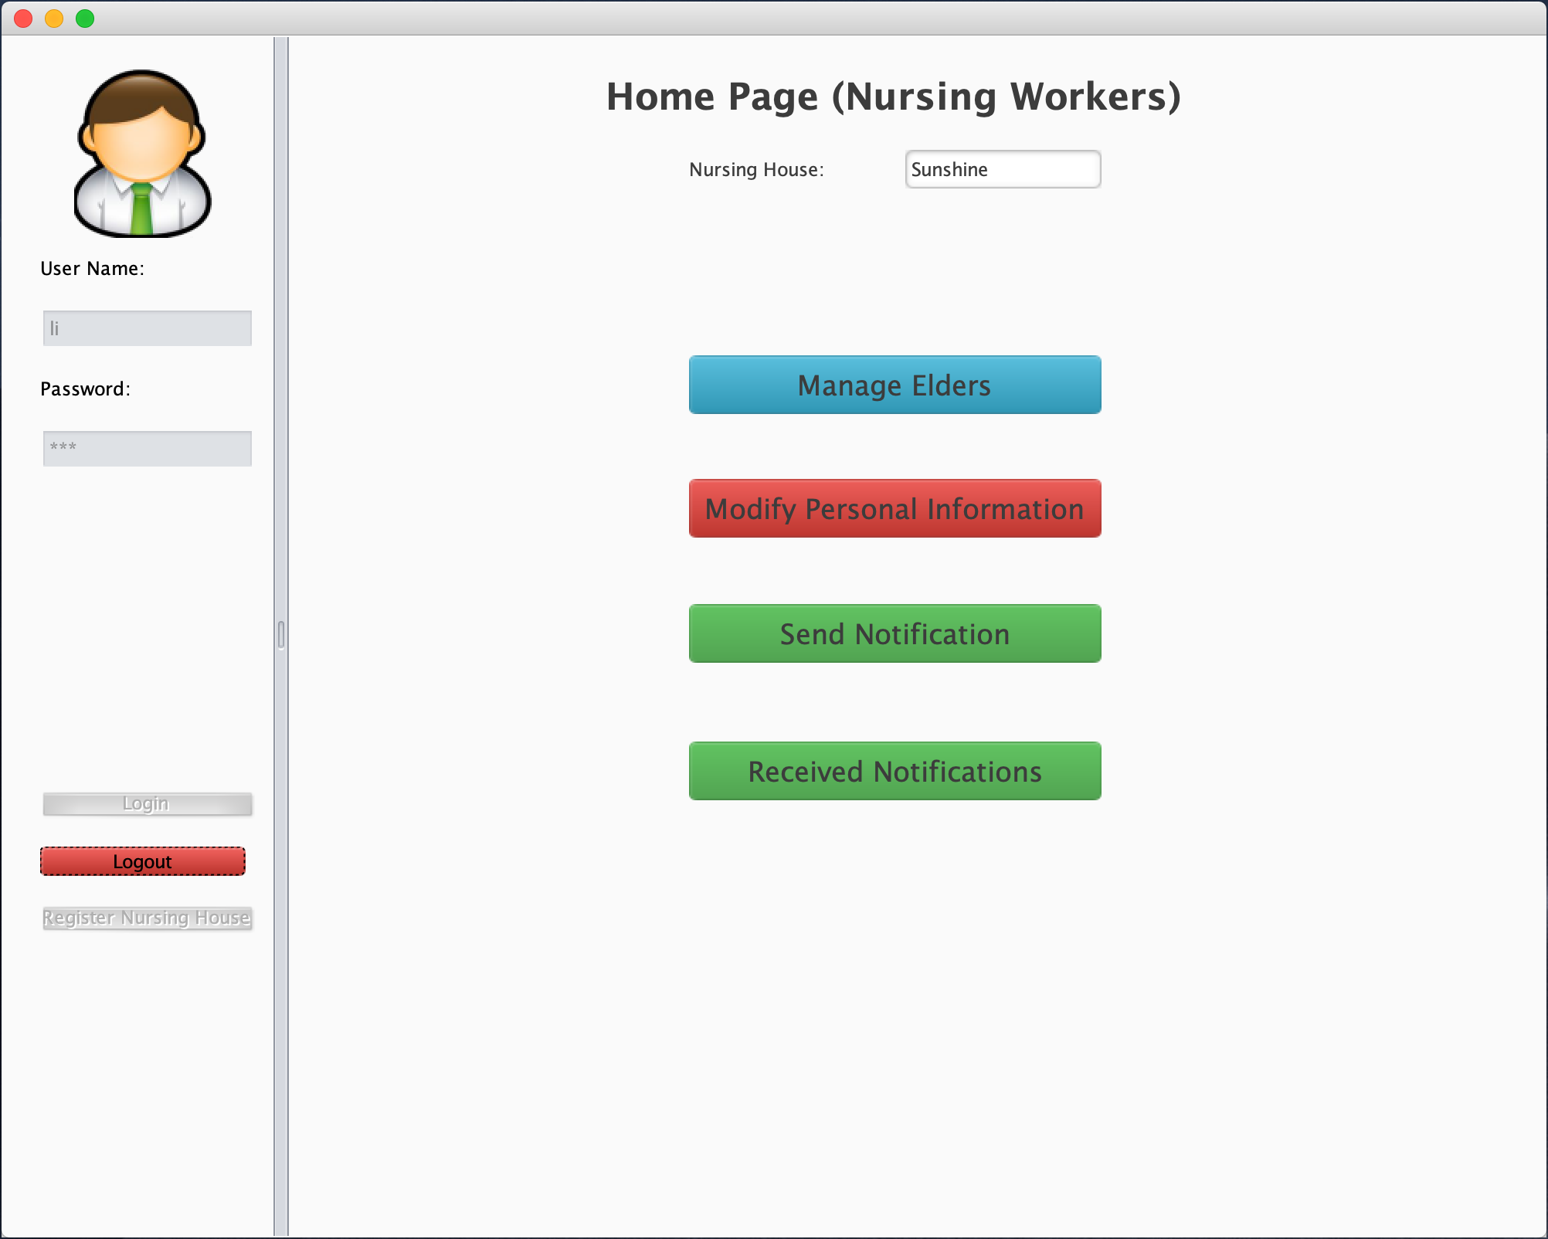
Main Screenshots
1
点击添加标题
Nursing Worker Interface

Slide 21
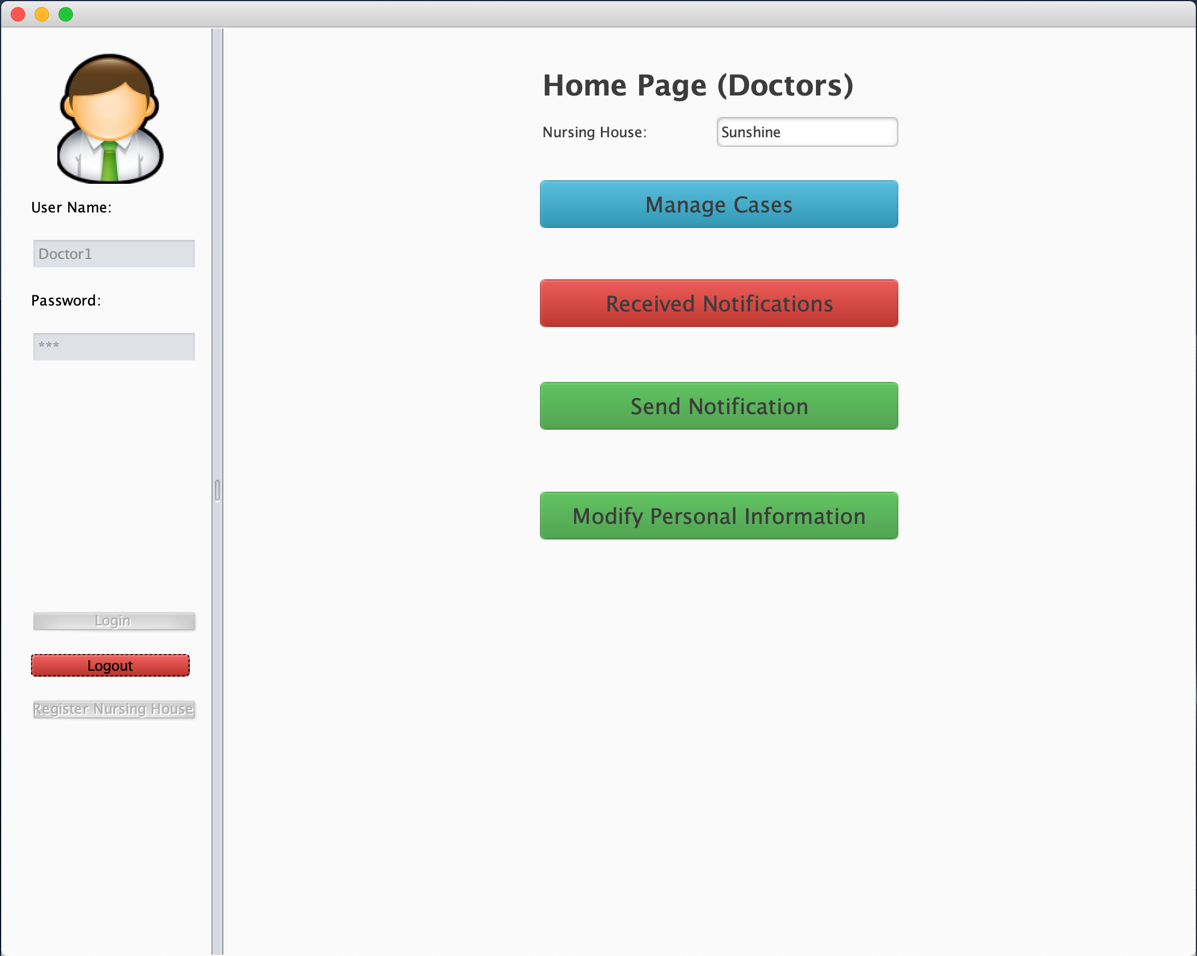
Main Screenshots
1
点击添加标题
Doctor Interface

Slide 22
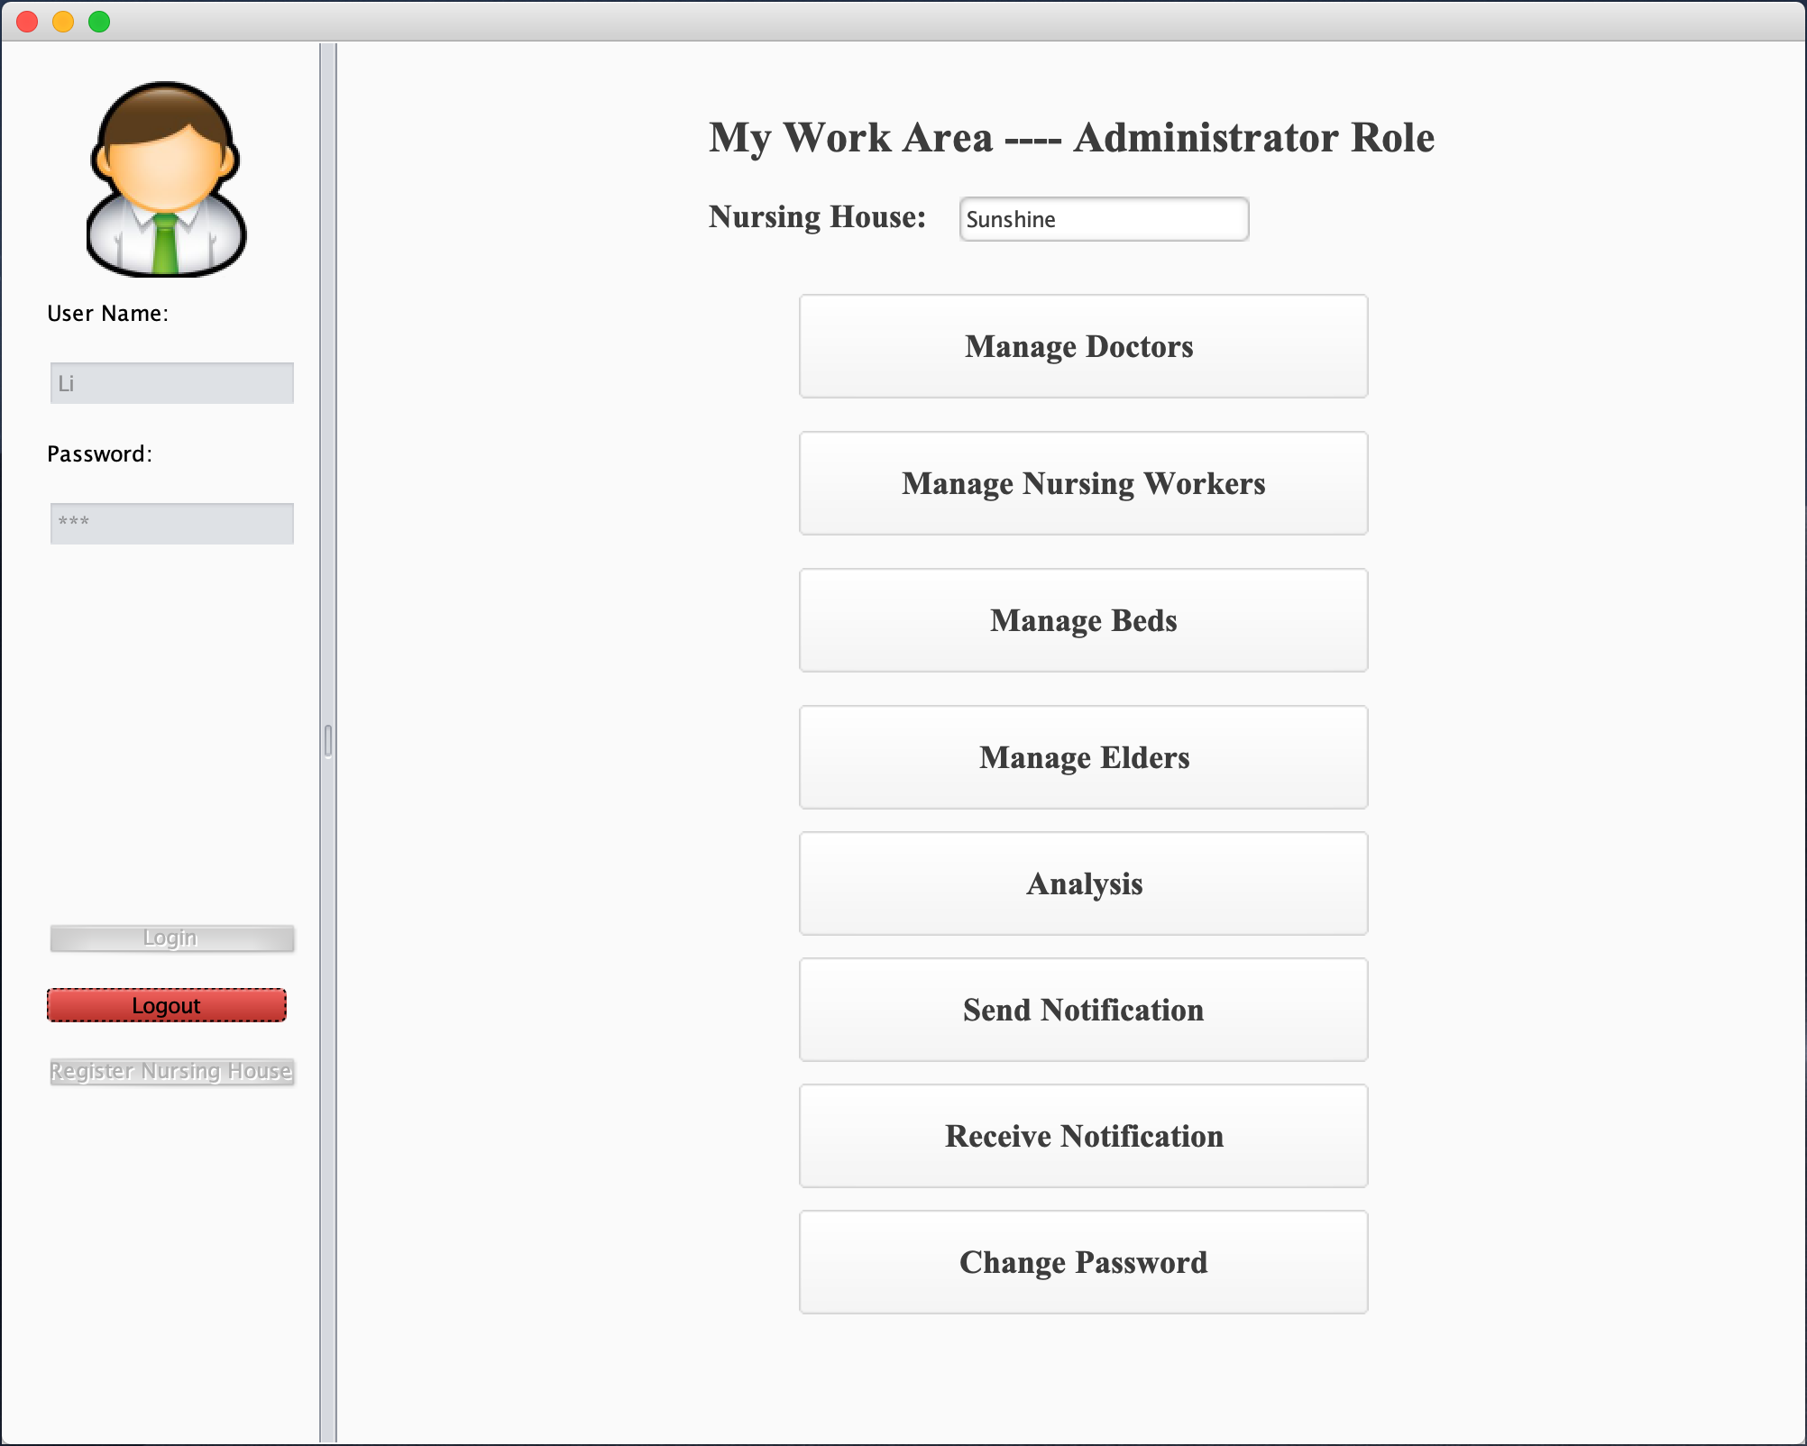
Main Screenshots
1
点击添加标题
Low-level administrator Interface

Slide 23
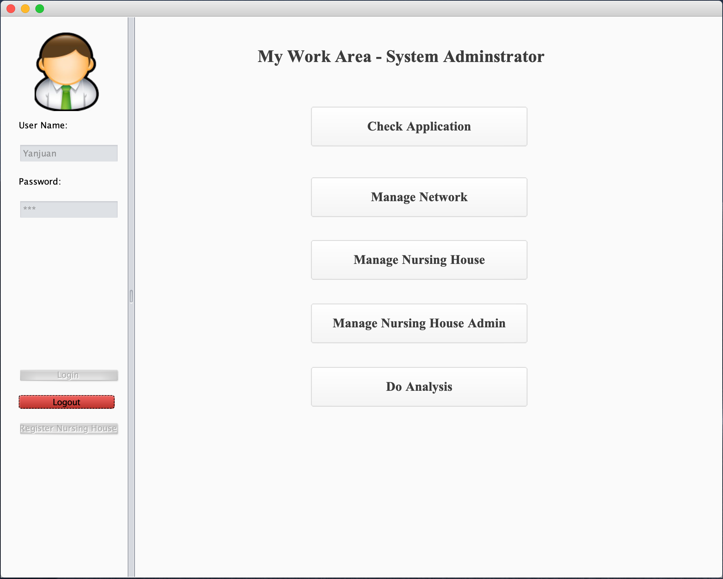
Main Screenshots
1
点击添加标题
High-level administrator Interface

Slide 24
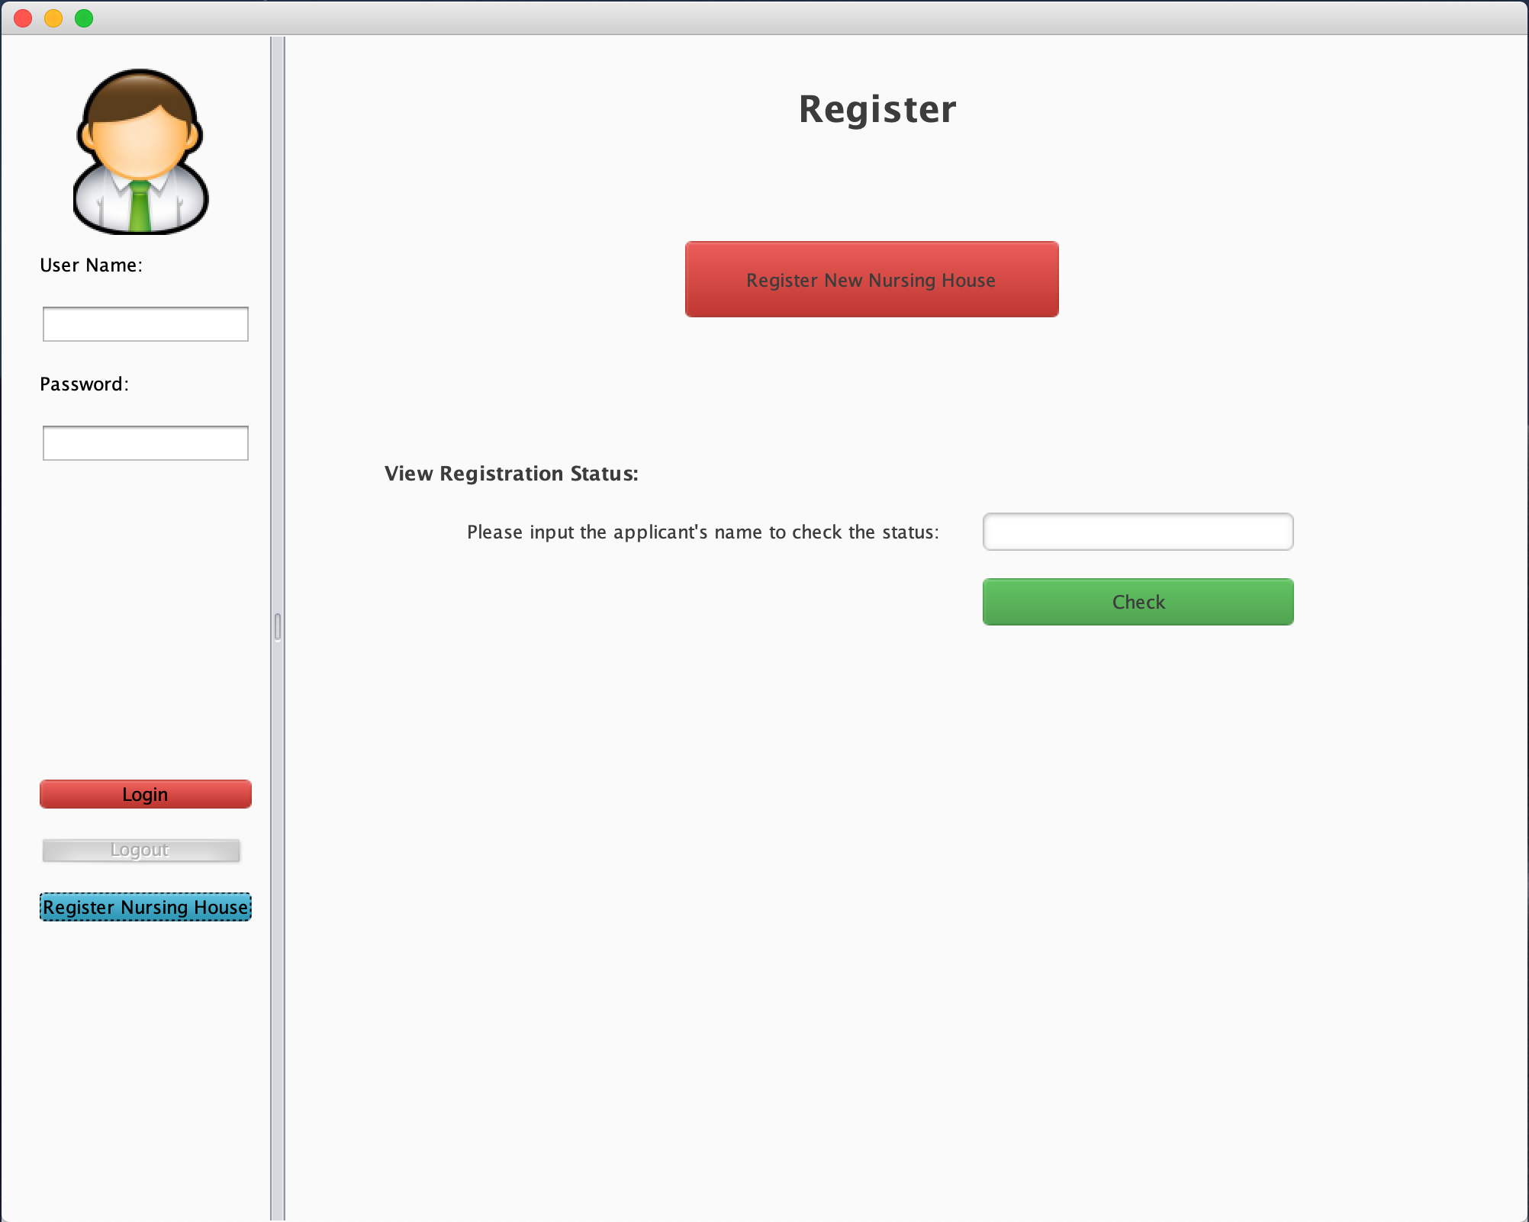
Main Screenshots
1
点击添加标题
Register Interface

Slide 25
THANKS !
Team Member：JingyiCui, YanjuanLi, JinLi

